Slide 1
Baudouin de Courtenay and Ferdinand de Saussure

Slide 2
Baudouin de Courtenay and Kazan linguistic school.
Ferdinand de Saussure’s linguistic theories.

Slide 3
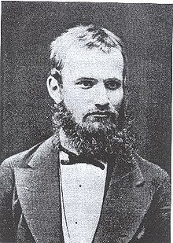
Baudouin de Courtenay and Kazan linguistic school
Baudouin de Courtenay (1845 –1929) was a Polish linguist and Slavist, best known for his theory of the phoneme and phonetic alternations.
For most of his life Baudouin de Courtenay worked at Imperial Russian universities:
Kazan, Tartu and St. Petersburg

Slide 4
Baudouin de Courtenay and Kazan linguistic school
established the Kazan school of linguistics in the mid-1870s
his work had a major impact on 20th-century linguistic theory, and it served as a foundation for the three major schools of phonology (Leningrad, Moscow and Prague)
developed synchronic linguistics, the study of contemporary spoken languages

Slide 5
Baudouin de Courtenay and Kazan linguistic school
Socio-psychological approach
“Since language is common only for human society, apart from psychological aspect we should always note social aspect as well. Not only individual psychology, but also sociology (still not satisfyingly developed) should both serve as the foundation for linguistics”.
Baudouin de Courtenay

Slide 6
Baudouin de Courtenay and Kazan linguistic school
Equality of languages
“There are no privileged, aristocratic languages, all languages deserve the linguist’s attention and in-depth study – that is the motto of Kazan linguistic school”
Baudouin de Courtenay

Slide 7
Baudouin de Courtenay and Kazan linguistic school
Study of local spoken languages
Kazan University is in unique condition : it is situated in the area inhabited by the representatives of at least three language families – Slavic, Turkic and Finno-Ugric.
Baudouin de Courtenay brought back to life the department of Turkic and Finnish languages in the university, optional teaching of Tatar for all the interested, attracted Tatar students and actively supported them in studies.

Slide 8
Baudouin de Courtenay and Kazan linguistic school
Correlation between synchronic and diachronic language studies
Drawing upon Humboldt’s antinomy of stability and flexibility in the language, KLS scholars developed the study about dichotomy of dynamics and statics in the language.
“There is no immobility in the language, like in the whole of nature, everything lives, everything moves, everything changes. Calmness, pause, standstill is a seeming occurrence, and is a particular case of moving under condition of minimal changes. Language statics is just a particular case of its dynamics or rather cinematics”.
Baudouin’s student from St. Petersburg academician L.V. Tscherba called his teacher’s method “dynamic synchrony”.

Slide 9
Baudouin de Courtenay and Kazan linguistic school
Major scientific problems developed by KLS
strict distinction of a sound and a letter;
distinction of phonetic and morphologic word divisibility;
distinction of pure phonetic (anthropophonic) and psychic elements in the language;
distinction of changes taking place regularly a language and changes which used to happen in the history;
advantage of a living language examination;
importance of analyzing and dividing linguistic units according to their distinctive features;
aiming at theoretical generalizations, which are necessary for every real science.

Slide 10
Baudouin de Courtenay and Kazan linguistic school
Major achievements
Kazan linguists considered the language to be a constantly changing complicated system of heterogeneous units (phonetic, morphologic, syntactic, etc.).
Discovered key units of each linguistic level: a phoneme, a morpheme, a lexeme, a syntagma, etc.
Coined the term morpheme.
Drew distinction between dynamics and statics in language and between language and speech
Shaped the modern usage of the term phoneme
”the psychological equivalent of a speech sound”
ideal sound image in the speaker’s mind which represents their (perhaps imperfectly realized) intention in production
Advanced the theory of phonetic alternations. Distinguished between physiophonetic (phonological) and psychophonetic (morphophonological) alternations.

Slide 11
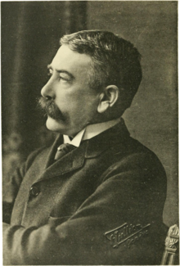
Ferdinand de Saussure
Ferdinand de Saussure (1857-1913),
Swiss linguist, a key figure in European linguistics at the turn of the century
Cours de linguistique générale (1916) – de Saussure’s lectures on linguistics
published by his pupils in Geneva
Its publication was compared to Copernican revolution

Slide 12
Ferdinand de Saussure
formalized and made explicit the two fundamental dimensions of linguistic study: synchronic and diachronic, both essential in any adequate course of linguistic study or linguistic instruction
distinguished the linguistic competence of the speaker (language) and the actual phenomena or data of linguistics (speech)
any language must be described synchronically as a system of interrelated elements, lexical, grammatical and phonological, and not as an aggregate of self-sufficient entities. Linguistic terms are to be defined relatively to each other, not absolutely.

Slide 13
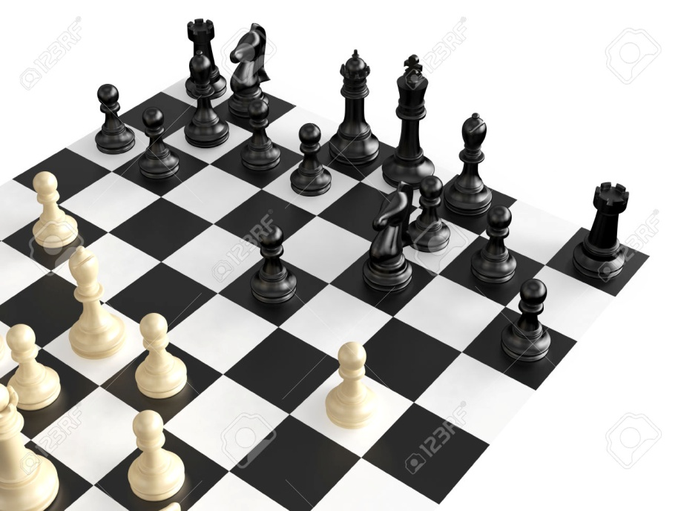
Ferdinand de Saussure
But of all comparisons that might be imagined, the most fruitful is the one that might be drawn between the functioning of language and a game of chess. In both instances we are confronted with a system of values and their observable modifications. A game of chess is like an artificial realization of what language offers in a natural form.

Slide 14

Ferdinand de Saussure
Language is a system of values.
Take a knight, for instance. By itself is it an element in
the game? Certainly not, for by its material make-up—outside its square and the other conditions of the game—it means nothing to the player; it becomes a real, concrete element only when endowed with value and wedded to it. Suppose that the piece happens to be destroyed or lost during a game. Can it be replaced by an equivalent
piece? Certainly. Not only another knight but even a figure
shorn of any resemblance to a knight can be declared identical provided the same value is attributed to it. We see then that in semiological systems like language, where elements hold each other in equilibrium in accordance with fixed rules, the notion of identity blends with that of value and vice versa.

Slide 15
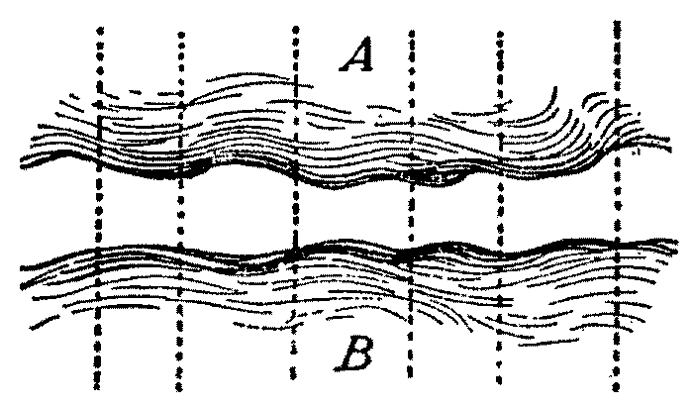
Ferdinand de Saussure
Language is a system of values.
The characteristic role of language with respect to thought is not to create a material phonic means for expressing ideas but to serve as a link between thought and sound …
Thought, chaotic by nature, has to become ordered in the process of its decomposition. Neither are thoughts given material form nor are sounds transformed into mental entities; the somewhat mysterious fact is rather that "thought-sound" implies division, and that language works out its units while taking shape between two shapeless masses.
Visualize the air in contact with a sheet of water; if the atmospheric pressure changes, the surface of the water will be broken up into a series of divisions, waves; the waves resemble the union or coupling of thought with phonic substance.
A – jumbled ideas
B – vague plane of sounds

Slide 16
Ferdinand de Saussure
In a language the elements of the system are interrelated in the two fundamental dimensions of synchronic linguistic structure:
syntagmatic, in line with the succession of an utterance and
paradigmatic (associative), in systems of contrastive elements or categories
modern
linguistics
Saussure’s structural (systemic) approach to language

Slide 17
Ferdinand de Saussure
Differentiation between external linguistics and internal linguistics:
My definition of language presupposes the exclusion of everything that is outside its organism or system—in a word, of everything known as "external linguistics." But external linguistics deals with many important things—the very ones that we think of when we begin the study of speech.
External linguistics deals with
links between the history of the language and history of the people
links between language and political history
relations between language and social institutions
geographical spread of languages and dialects

Slide 18

Ferdinand de Saussure
Saussure’s semiology
The linguistic sign is a two-sided psychological entity . It unites not a thing and a name but a concept and a sound image.
The sound image is not the material sound, a purely physical
thing, but the psychological imprint of the sound, the impression that it makes on our senses.

Slide 19
Ferdinand de Saussure’s semiology
SIGN
(the whole)
THE SIGNIFIED (concept)
THE SIGNIFIER (the sound-image)

Slide 20

Ferdinand de Saussure’s semiology
The bond between the signifier and the signified is arbitrary. >> The linguistic sign is arbitrary.
What is the connection between the concept “sister” and the succession of sounds which signifies this concept in a language?

Slide 21
Ferdinand de Saussure’s semiology
Sociological linguistics
The arbitrary nature of the sign explains in turn why the social
fact alone can create a linguistic system. The community is necessary if values that owe their existence solely to usage and general acceptance are to be set up ; by himself the individual is incapable of fixing a single value.

Slide 22

Ferdinand de Saussure’s semiology
The signifier has linear nature:
The signifier, being auditory, is unfolded solely in time from
which it gets the following characteristics : (a) it represents a span, and (b) the span is measurable in a single dimension; it is a line.

Slide 23
Ferdinand de Saussure’s semiology
Linguistics studies signs and their relations, they are the concrete entities of linguistics.
The linguistic entity exists only through the associating of the
signifier with the signified. Whenever only one element is retained, the entity vanishes.
A succession of sounds is linguistic only if it supports an idea. Considered independently, it is material for a physiological
study, and nothing more than that.
The same is true of the signified as soon as it is separated from
its signifier. Considered independently, concepts like "house,"
"white," "see," etc. belong to psychology. They become linguistic
entities only when associated with sound-images; in language, a
concept is a quality of its phonic substance just as a particular
slice of sound is a quality of the concept.

Slide 24

Ferdinand de Saussure’s semiology
The two-sided linguistic unit has often been compared with the
human person, made up of the body and the soul. The comparison is hardly satisfactory. A better choice would be a chemical compound like water, a combination of hydrogen and oxygen; taken separately, neither element has any of the properties of water.

Slide 25

Ferdinand de Saussure’s semiology
The linguistic entity is not accurately defined until it is
delimited, i.e. separated from everything that surrounds it on the
phonic chain. These delimited entities or units stand in opposition to each other in the mechanism of language.
Delimitation is only possible through meaning.
When we hear an unfamiliar language, we are at a loss to say how the succession of sounds should be analyzed, for analysis is impossible if only the phonic side of the linguistic phenomenon is considered. But when we know the meaning and function that must be attributed to each part of the chain, we see the parts detach themselves from each other and the shapeless ribbon break into segments.

Slide 26
Ferdinand de Saussure’s semiology
To summarize: language does not offer itself as a set of predelimited signs that need only be studied according to their meaning and arrangement ; it is a confused mass, and only attentiveness and familiarization will reveal its particular elements.
The unit has no special phonic character, and the only definition that we can give it is this: it is a slice of sound which to the exclusion of everything
that precedes and follows it in the spoken chain is the signifier of a certain concept.

