Slide 1
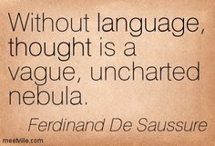
General Linguistics

Slide 2
Study of language before the 19th century
Ancient India.
Ancient China.
Ancient Greece and Rome.
Language studies in Europe in the Middle Ages and in the Renaissance.
The Port-Royal Grammar.

Slide 3
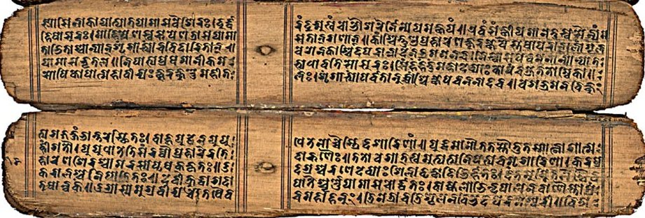
Ancient India
Indian theory and practice was definitely in advance of anything achieved in Europe or elsewhere before contact had been made with Indian work in the 18th century.
The Hindu tradition of linguistics had its origins in the 1st millennium BC and was stimulated by changes in Sanskrit, the sacred language of religious texts.

Slide 4
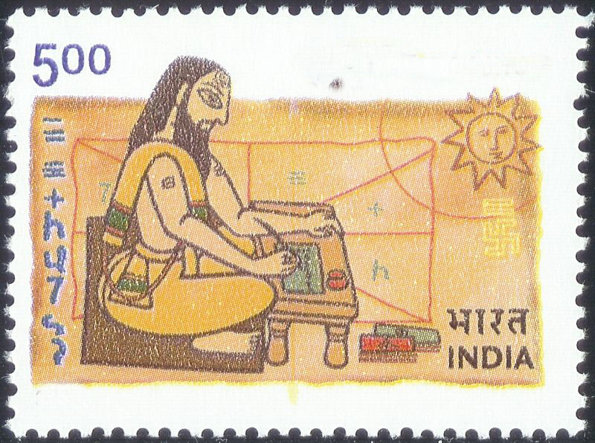
Ancient India
Panini:
wrote a grammar of Sanskrit
(middle of the 1st millennium BC)
called Astadhyāyī
(literally 'eight books').
Panini’s grammar:
phonetics (including differences between words pronounced in isolation and in connected speech)
morphology (rules of word formation)

Slide 5
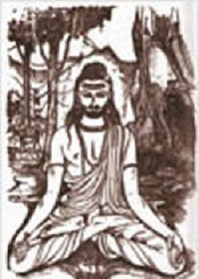
Ancient India
Bhartrihari (5th c.)
Vākyapadīya states that the sentence should be interpreted as a single unit which conveys its meaning 'in a flash', just as a picture is first perceived as a unity, notwithstanding subsequent analysis into its component coloured shapes.
In other words, the sentence is not understood as a sequence of words put together, but the full meaning of each word is only understood in the context of the other words around it.

Slide 6
Ancient India
Indian linguistic theory set out three requirements for a string of words to be considered a sentence:
(ākānksā) the words are members of suitable grammatical categories (parts of speech) with appropriate morphology (inflection),
(yogyatā) the words must be 'semantically appropriate' to one another,
(samnidhi) the words must be uttered as a concatenation.

Slide 7
Ancient China
As in ancient Greece, early Chinese thinkers were concerned with the relationship between names and reality.
Confucius (6th c. BCE) emphasized the moral commitment implicit in a name:
"Good government consists in the ruler being a ruler, the minister being a minister, the father being a father, and the son being a son... If names be not correct, language is not in accordance with the truth of things." (Analects 12.11,13.3).

Slide 8
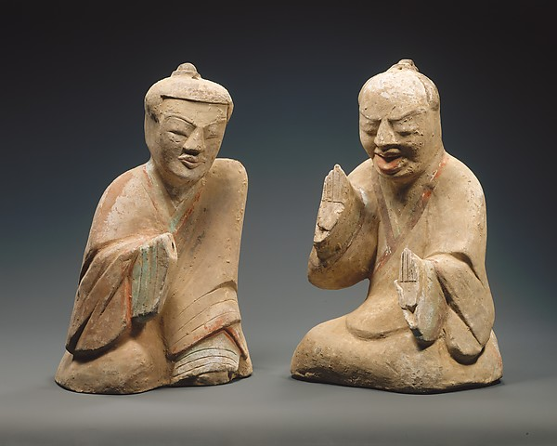
Ancient China
The various Chinese philosophers assigned to the School of Names dedicated themselves to defining the proper semantic relations between names (ming, words) and the things or kinds of things to which they refer (shi, objects, events, situations).

Slide 9
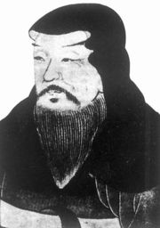

Ancient China
Xǔ Shèn (c. 58 – c. 147 CE), the author of the first Chinese dictionary with character analysis, as well as the first to organize the characters by shared components.
The dictionary contains over 9,000 character entries under 540 radicals, explaining the origins of the characters .

Slide 10
Ancient China
Due to the syllabic nature of the Chinese language and the absence of inflection:
phonological studies began late
little attention was paid to grammar studies
The ancient commentators on the classics paid much attention to syntax and the use of particles. But the first Chinese grammar, in the modern sense of the word, was produced in the late 19th century. It was based on the Latin (prescriptive) model.

Slide 11
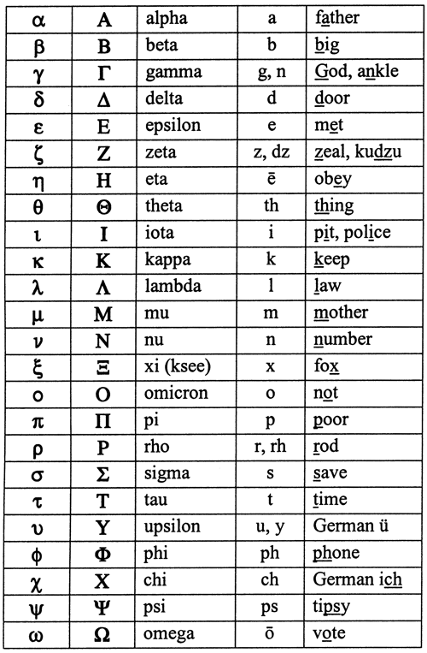
Ancient Greece and Rome
Alphabet
Early in the 1st millennium BC an alphabetic system for writing the Greek language was worked out. However, during the dark ages the knowledge of writing was lost and the Greek alphabet as we know it today developed on the basis of Phoenician script.

Slide 12

Ancient Greece and Rome
Much of early linguistic enquiries fell under the general heading of philosophia which embraced in fact the whole realm of human knowledge.
The 5th-century rhetoricians left observations of language in their records.

Slide 13
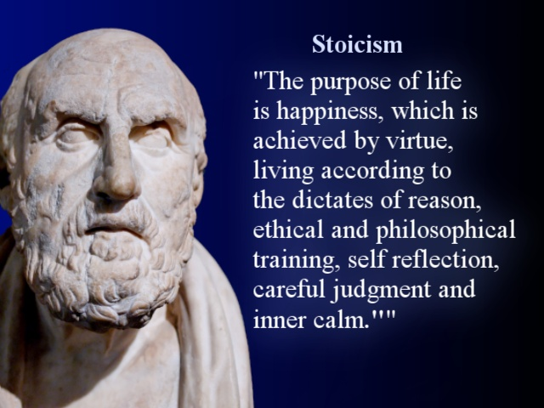
Ancient Greece and Rome
The Stoics
Under the Stoics linguistics achieved a defined place within the overall context of philosophy.
Their founder, Zeno (4th – 3rd c. BC), was a bilingual whose first language was a Semitic one and who learned Greek in later life.

Slide 14
Ancient Greece and Rome
The Stoics
“First comes the impression, then the mind, making use of speech, expresses in words the experience produced by the impression”
“All things are discerned through dialectal studies”
“Most people are agreed that it is proper to begin the study of dialectic from that part of it dealing with speech”

Slide 15
Ancient Greece and Rome
The Stoics
formalized the dichotomy between form and meaning, distinguishing in language “the signifier” and “the signified”.
gave separate treatment to phonetics, grammar and etymology
systematically studied the differences between varieties of Greek
distinguished three aspects of a written letter: its phonetic value, its written shape and its name
studied the syllabic structures of the Greek language, differentiating between three types of sound sequences (actually occurring as meaningful part of discourse; possible according to the rules but actually not occurring; phonologically impossible)
divided words into morphological classes
created the noun category of case
differentiated between the temporal and the aspectual meanings inherent in the tense forms of the verb

Slide 16
Ancient Greece and Rome
Controversies about the language
NATURE vs CONVENTION
REGULARITY or ANALOGY vs IRREGULARITY or ANOMALY

Slide 17
Ancient Greece and Rome
Plato (5th – 4th c. BC) Cratylus (dialogue about correctness of names)
Cratylus : An artist uses color to express the essence of his subject in a painting. In much the same way, the creator of words uses letters containing certain sounds to express the essence of a word's subject. There is a letter that is best for soft things, one for liquid things, and so on. The best possible way to speak consists in using names all (or most) of which are like the things they name (that is, are appropriate to them), while the worst is to use the opposite kind of names.
Hermogenes: names have come about due to custom and convention. They do not express the essence of their subject, so they can be swapped with something unrelated by the individuals or communities who use them

Slide 18
Ancient Greece and Rome
Aristotle (4th c. BC):
Language is by convention since no names arise naturally.
Speech is the representation of the experiences of the mind and writing is the representation of speech.

Slide 19
Ancient Greece and Rome
Protagoras (5th c. BC):
considered the nominal category of gender in Greek and is reported to have wished μῆνις ‘anger’ and πἠληξ ‘helmet” to be masculine instead of feminine
set out different types of sentences based on association between the semantic function and the grammar structure: wish, statement, question, command.

Slide 20
Ancient Greece and Rome
Plato:
divided the sentence into a nominal (ὅνομα) and a verbal (ρῆμα) component
Aristotle
added a third class of syntactic component (σύνδεσμοι) covering what later became conjunctions, the article and pronouns
gave a formal definition of a word as a linguistic unit: a component of a sentence having a meaning of its own but not further divisible into meaningful units

Slide 21
Ancient Greece and Rome
The Alexandrians (4th c. BC – 5th c. AD)(unlike the Stoics)
were mainly interested in language as a part of literary studies
adhered to the analogist position
devoted special attention to Homeric studies, correcting Homer’s texts and determining standards of acceptability

Slide 22
Ancient Greece and Rome
Dionysius Thrax (170-90 BC)
the author of the first surviving description of the Greek language
“Grammar is the practical knowledge of the general usages of poets and prose writers. It has six parts:
accurate reading (aloud) with due regard to the prosodies
explanation of the literary expressions in the works
provision of notes on phraseology and subject matter
discovery of etymologies
working out of analogical regularities
appreciation of literary compositions, which is the noblest part of grammar

Slide 23
Ancient Greece and Rome
Dionysius Thrax ‘s Grammar
gives an account of the phonetic values of Greek letters
singles out two basic units of description: the sentence and the word
distinguishes eight word classes: noun, verb, participle, article, pronoun, preposition, adverb, conjunction
each word class is followed by the grammatical categories applicable to it

Slide 24
Ancient Greece and Rome
Roman linguistics was largely the application of Greek thought, Greek controversies and Greek categories to the Latin language.

Slide 25
Ancient Greece and Rome
Varro (116 BC – 27 BC)
De lingua latina libri XXV (or On the Latin Language in 25 Books, of which six books survive, partly mutilated)
threefold division of language studies: etymology, morphology and syntax
language developed from an original limited set of primal words imposed on things so as to refer to them; these primal words produced many more other words through change of their form
both analogy and anomaly work in word formation and in meanings
distinguishes between derivational and inflexional formation

Slide 26
Ancient Greece and Rome
Priscian (5th c) taught Latin in Constantinople
Institutiones Grammaticae (Institutes of Grammar) –
extensive, detailed and comprehensive description of the Latin language of the classical authors which served as the basis for grammatical theory for eight centuries and became the foundation of Latin teaching until present day
was the standard textbook for the study of Latin during the Middle Ages
The grammar is divided into eighteen books, of which the first sixteen deal mainly with sounds, word-formation and inflexions; the last two deal with syntax.
classical system of eight word classes laid down by Thrax, with the omission of article and separate recognition of interjection

Slide 27
Language studies in Europe in the Middle Ages and in the Renaissance
Speculative grammar (esp. 13th century)
from the Latin speculum “mirror”, indicating a belief that language reflects the reality underlying the physical world.
In accordance with this belief, speculative grammarians searched for a universal grammar, valid for all languages despite their differences.
The categories of this grammar would correlate with the categories of logic, epistemology, and metaphysics; e.g., nouns and pronouns were thought to express the metaphysical category of “permanence,” whereas verbs and participles expressed “becoming.”

Slide 28
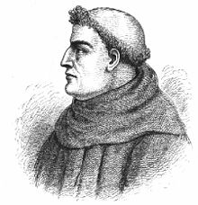
Language studies in Europe in the Middle Ages and in the Renaissance
Speculative grammar (esp. 13th century)
Roger Bacon:
grammar is one and the same in all languages in its substance, surface differences between them are merely accidental variations

Slide 29
Language studies in Europe in the Middle Ages and in the Renaissance
Speculative grammar (esp. 13th century)
Speculative grammarians took over Priscian grammar but relabeled the parts of speech to show their “modes of signifying.”
So many of their works were titled De modis significandi
(“The Modes of Signifying”) that they have come to be called the Modistae.

Slide 30
Language studies in Europe in the Middle Ages and in the Renaissance
Speculative grammar
modi essendi
(properties of things)
modi intelligendi activi modi intelligendi passivi
(active modes of understanding) (properties of things as understood by the mind)
modi significandi activi modi significandi passivi
(active modes of signification) (properties of things as expressed by language)
модуси існування – модуси поняття – модуси позначення
Every part of speech represents reality through a certain mode, or from a particular point of view.
Every category of a part of speech is itself a mode contributing its own semantic component.

Slide 31
Language studies in Europe in the Middle Ages and in the Renaissance
Speculative grammar
“Grammar is above all concerned with syntax”
An acceptable sentence must satisfy three conditions:
the word classes must constitute a syntactic construction
(e.g. N + V)
the words must show appropriate inflectional categories
the words must collocate as individual lexical items
Example: cappa nigra *cappa categorica
*lapis amat filium

Slide 32
Language studies in Europe in the Middle Ages and in the Renaissance
Speculative grammar
Other syntactic innovations
“One part of a construction stands to another either as dependent on it or as satisfying its dependence”
transitive and intransitive as categories of syntactic constructions

Slide 33
Language studies in Europe in the Middle Ages and in the Renaissance
Before speculative grammar | Speculative grammar
Grammar was directed towards writers of the classic literature | Grammar is exclusively concerned with its place among liberal arts
choice of examples

Slide 34
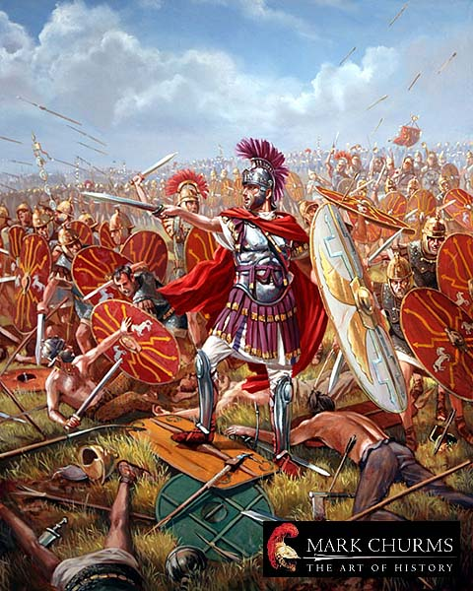
Language studies in Europe in the Middle Ages and in the Renaissance
Henry d'Andeli, a 13th-century Norman poet
“Battle of the Seven Arts”
classical authors (rhetoric) based in Orleans
battle against the seven arts based in Paris
( centre of logic and speculative grammar)
Leaders:
Priscian vs Aristotle
Gram loquitur, Dia vera docet, Rhet verba colorat, Mus canit,
Ar numerat, Geo ponderat, As docet astra

Slide 35
Language studies in Europe in the Middle Ages and in the Renaissance
Renaissance
native grammars and dictionaries of European languages were written
the Bible was translated into a number of West European languages
diachronic studies were stimulated by comparison between classical Latin and contemporary Romance languages > causes of language change were discussed
invention of printing aroused interest in spelling reform
inspirations for a universal language, proposals of a universal grammar
Leibniz (1646-1716) looked forward to the day when controversies would be resolved by the mere invitation to sit down and calculate by means of a newly devised universal symbolization of thought, free from vagueness and uncertainties of a natural language

Slide 36
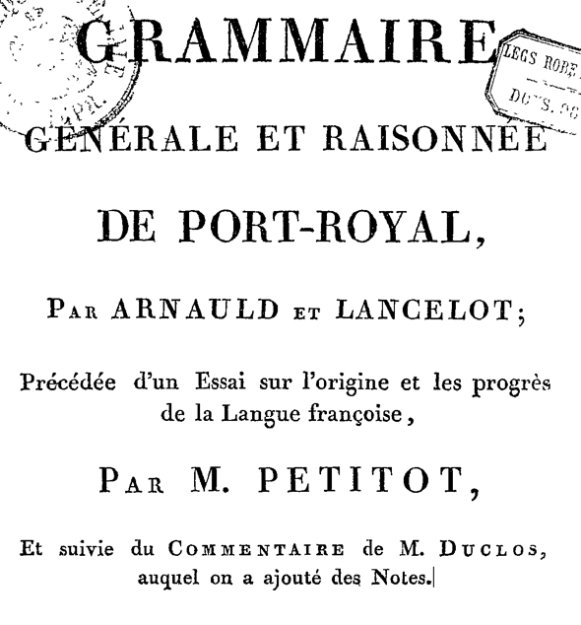
Port Royal Grammar
Port Royal Schools in France were religious and educational foundations in the mid-17th century.
Port Royal Grammar (1660):
mainly based on Descartes, French philosopher, mathematician, and scientist
asserted the supremacy of human reason (rationalist approach)
attempted to reveal the unity of grammar underlying the separate grammars of different languages
Grammar is simply mental processes, which are universal; therefore grammar is universal.

