Slide 1
Consciousness: Origin and Essence

Slide 2
Plan
1. The origin and essence of consciousness as a problem of philosophy, science and religion.
2. Consciousness as reflection and constructing of reality. The structure of consciousness.
3. Consciousness, language and communication.

Slide 3
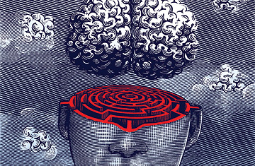
1. Consciousness as a philosophical problem.

